Slide 1

UK Employment Statistics By Job Type
Documentation

Slide 2

Table of Content
Slide 3 Overview
Slide 4 Employment Trends For The Past Two Years
Slide 5 Employees Trend for the past 2 years
Slide 6 Self-Employed Trend For The Past Two Years
Slide 7 Part-Time Workers Trend
Slide 8 Temporal Employment Trend
Slide 9 Unpaid Family Workers & Government Supported Employment Programmes Trends
Slide 10 Temporal Employment Reasons
Slide 11 Part-time Employment Reasons
Slide 12&13 Conclusion
Slide 14 Recommendation
Slide 15 Reference

Slide 3

Overview
This presentation contains detailed statistics on employment in the UK from June 2022 to May 2024. The dataset used for this presentation is structured into several key columns that provide insights into different aspects of Employment Job types.

Slide 4
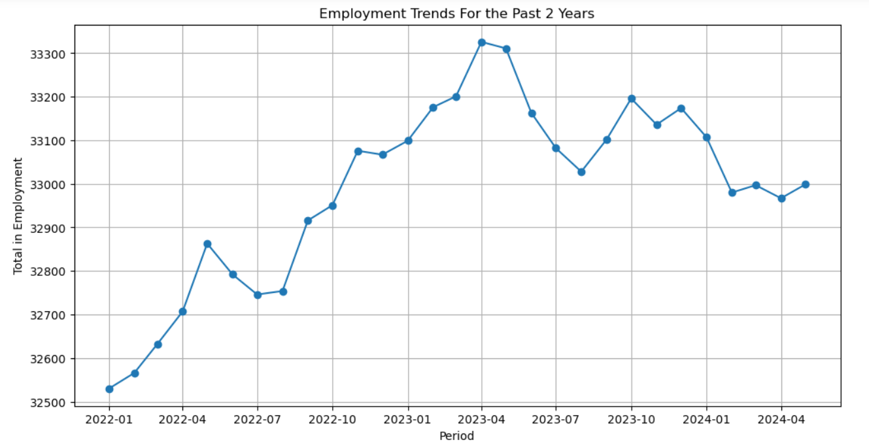
Employment Trends For The Past Two Years

Slide 5
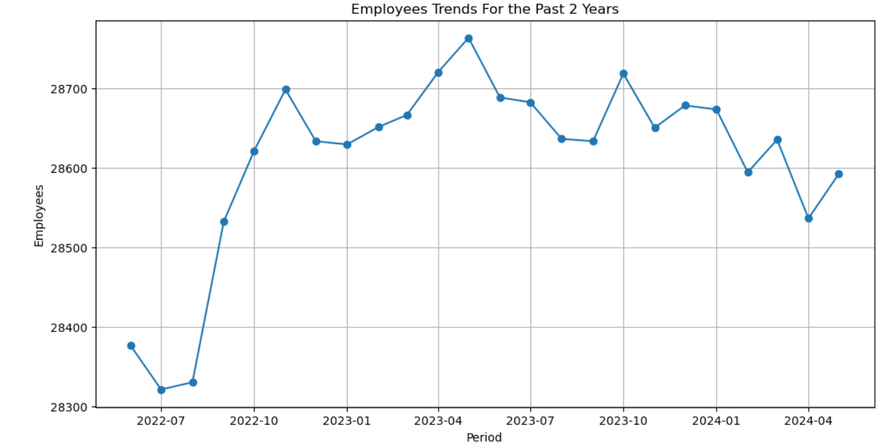
Employees Trend for the past 2 years

Slide 6
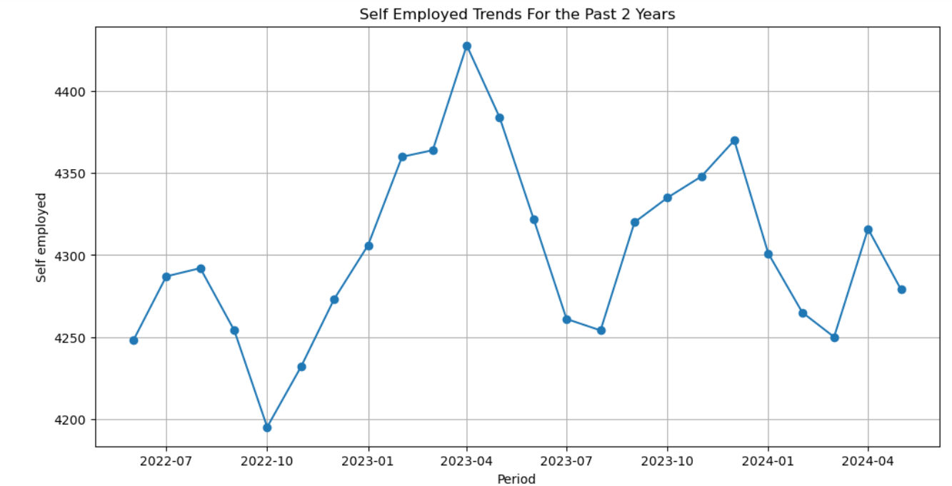
Self-Employed Trend For The Past Two Years

Slide 7
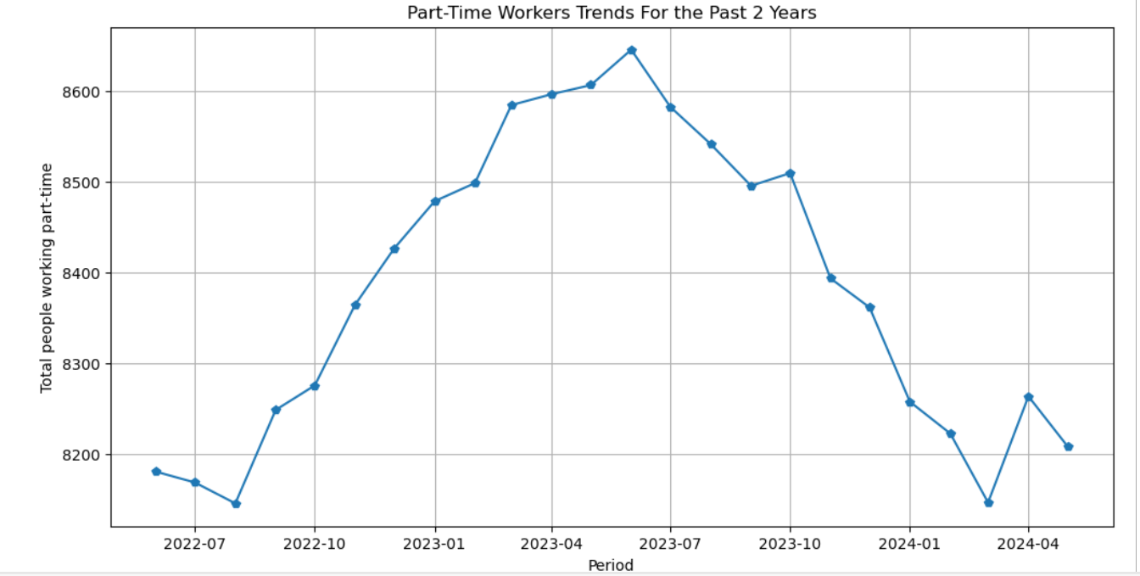
Part-Time Workers Trend

Slide 8
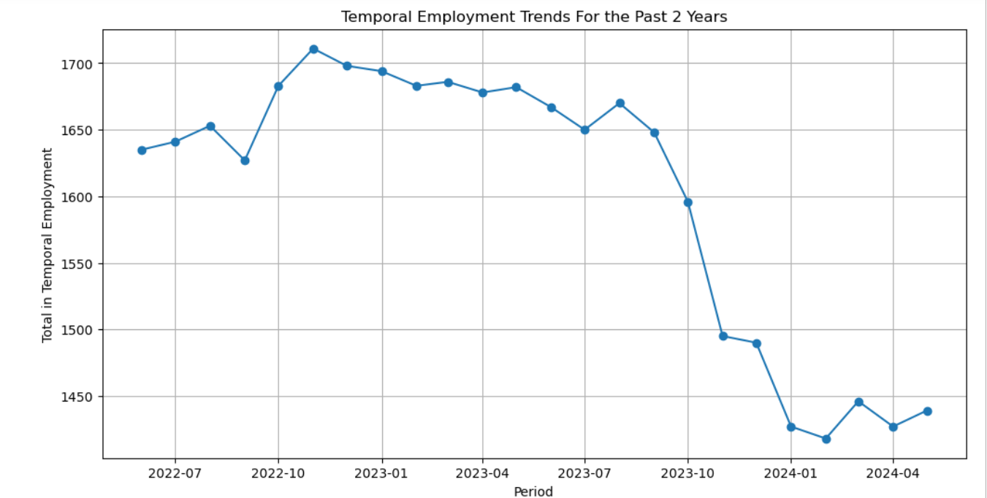
Temporal Employment Trend

Slide 9
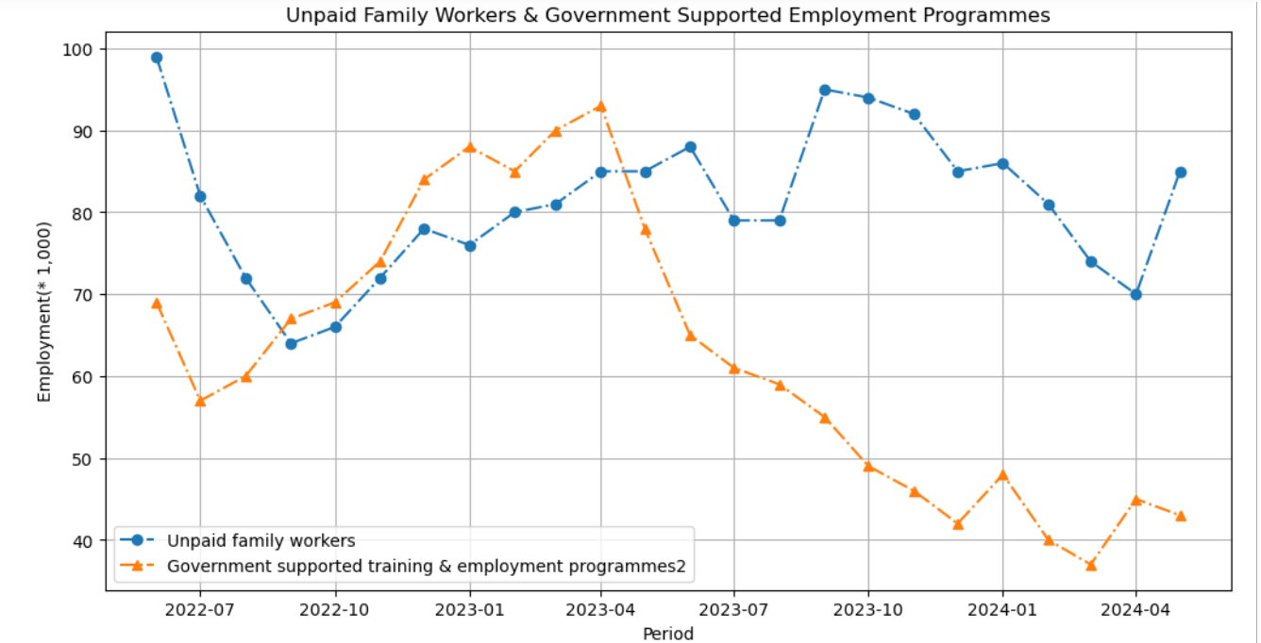
Unpaid Family Workers & Government Supported Employment Programmes Trends

Slide 10
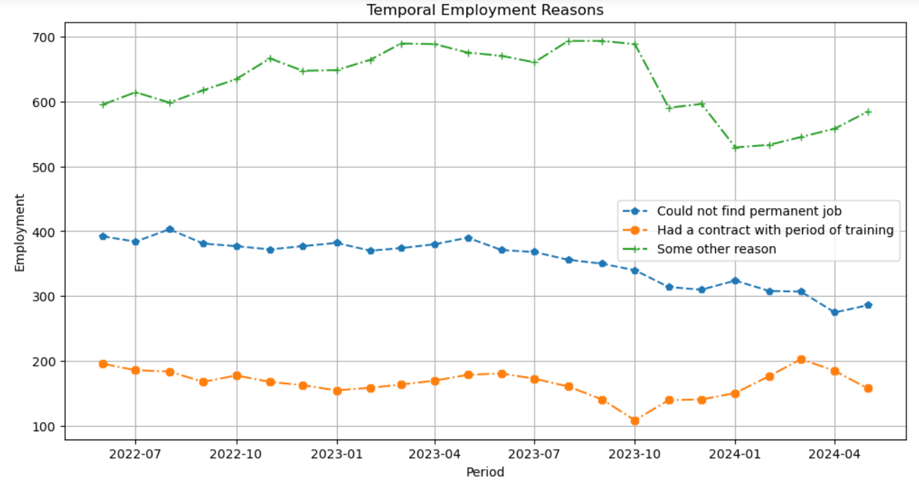
Temporal Employment Reasons

Slide 11
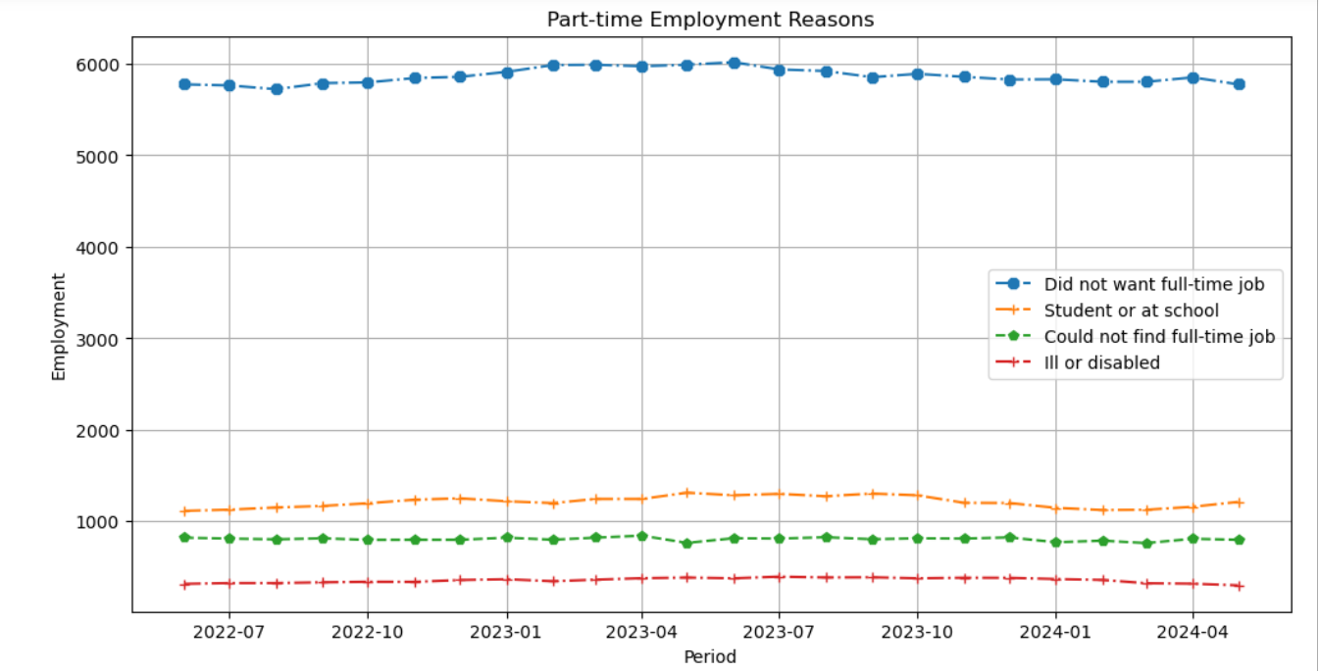
Part-time Employment Reasons

Slide 12
Conclusion
There is a general increase in total employment and the number of employees over the observed period, with a peak around April 2023.
The total number of people working full-time remains relatively stable with minor fluctuations between 24,487,000 and 24,850,000. The total number of people working part-time also shows minor fluctuations, ranging between 8,145,000 and 8,645,000.
The number of people working full-time and part-time, both employees and self-employed, remains relatively stable over the observed period with minor fluctuations. The self-employed category shows more variability, indicating potential sensitivity to economic changes or policy shifts. The number of workers with second jobs remains low and stable, suggesting that most individuals are relying on their primary job for income.
A significant portion of part-time employees prefer part-time work over full-time positions, indicating a preference for flexible working hours or work-life balance.
The total number of people working part-time has remained relatively stable in the past two years, with minor fluctuations between June 2022 and May 2024 peaking in June 2023.
The number of ill or disabled part-time employees shows some fluctuation, indicating a need for consistent support and accommodations for these workers.

Slide 13
Conclusion Continued..
The stable number of part-time employees who are students or at school suggests that part-time jobs are an important source of income for this demographic.
The number of temporary employees who could not find a permanent job starts at 392,000 in June 2022 and decreases to 286,000 in May 2024; a decrease from 24% to 19.9%
The number of temporary employees who did not want a permanent job remains relatively stable but shows a slight decrease towards the end of the period. The percentage of all employees in temporary employment remains consistent around 5-6%, indicating that while the absolute numbers fluctuate, the proportion relative to total employment remains stable.
The number of people in government-supported training and employment programs has decreased significantly, suggesting either a reduction in such programs or a shift towards other forms of employment.
The Unpaid Family Workers category remains stable and low throughout the period, indicating that it is not a significant component of the employment landscape.

Slide 14
Recommendations
Given the fluctuations in self-employment numbers, policies aimed at stabilizing and supporting self-employed individuals could be beneficial. This could include financial support, training programs, and better access to resources.
Continual monitoring of economic indicators that affect employment, such as inflation, economic growth, and industry performance, can help in making informed policy decisions to support employment.
Continue to support and promote flexible working conditions to accommodate the high number of part-time employees who prefer not to work full-time.
Develop and implement policies aimed at increasing the availability of full-time positions, particularly for those who are currently in part-time roles due to the inability to find full-time work.
Ensure that adequate support and accommodations are available for part-time employees who are ill or disabled, to help them maintain employment.
Maintain and potentially expand part-time employment opportunities for students, as this group relies on these jobs for income while pursuing their education.
Further investigate the high and stable number of temporary employees for "some other reason" to understand and address the underlying causes, ensuring these roles meet workers' needs and expectations.

Slide 15
Reference
The dataset used for this presentation was sourced from Office for National Statistics (ONS), released 18 July 2024, ONS website, statistical bulletin, Labour market overview, UK: July 2024.
The link to the website is indicated below:
Data Source

